Slide 1
ATM TRANSACTIONS THROUGH BIOMETRIC MODE
MARCH 7 2015
M.SAMYUKTHA

Slide 2
INTRODUCTION
"Biometrics is now being used in a number of ways to enhance the customer's shopping experience, as well as security
Biometric technology -- the use of a person's unique physical features such as fingerprints, facial image, and speech patterns to verify individual identities -- has been around for decades.
fingerprints nearly tied personal passwords as the primary preferred authentication method, 73 percent to 72 percent.
We've already made the critical move from signing a piece of paper to signing electronically…

Slide 3
Implementation….
Massachusetts's iCache- mini storage device that holds all of a consumer's credit card information.
SmartMetric - pint-sized biometric card that can store personal information including credit card numbers
Zwipe- a Norwegian technology firm
Mastercard - new fingerprint cards provided an added layer of security that meant spending limits were not required.
Voting
Passports(75%)
ID/Card Verification

Slide 4
Benifits over existing systems
Authentication
card cloning
card theft
signature duplication
increases security
increased revenues

Slide 5
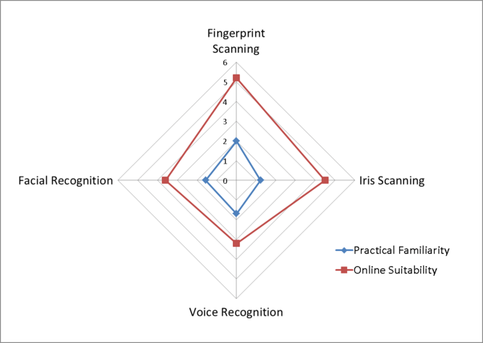
Comparitive survey of Biometrics

Slide 6
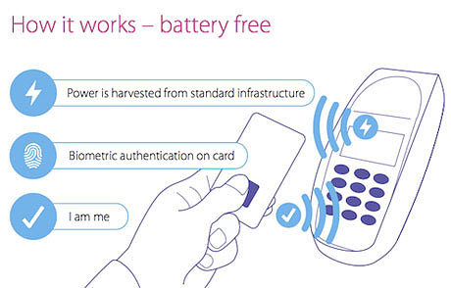
zwipe

Slide 7
Causes for concerns
retrofitting fingerprint scanners
Cost of:
ATM machines
fingerprint readers
fingerprint card strips
customer forms

Slide 8
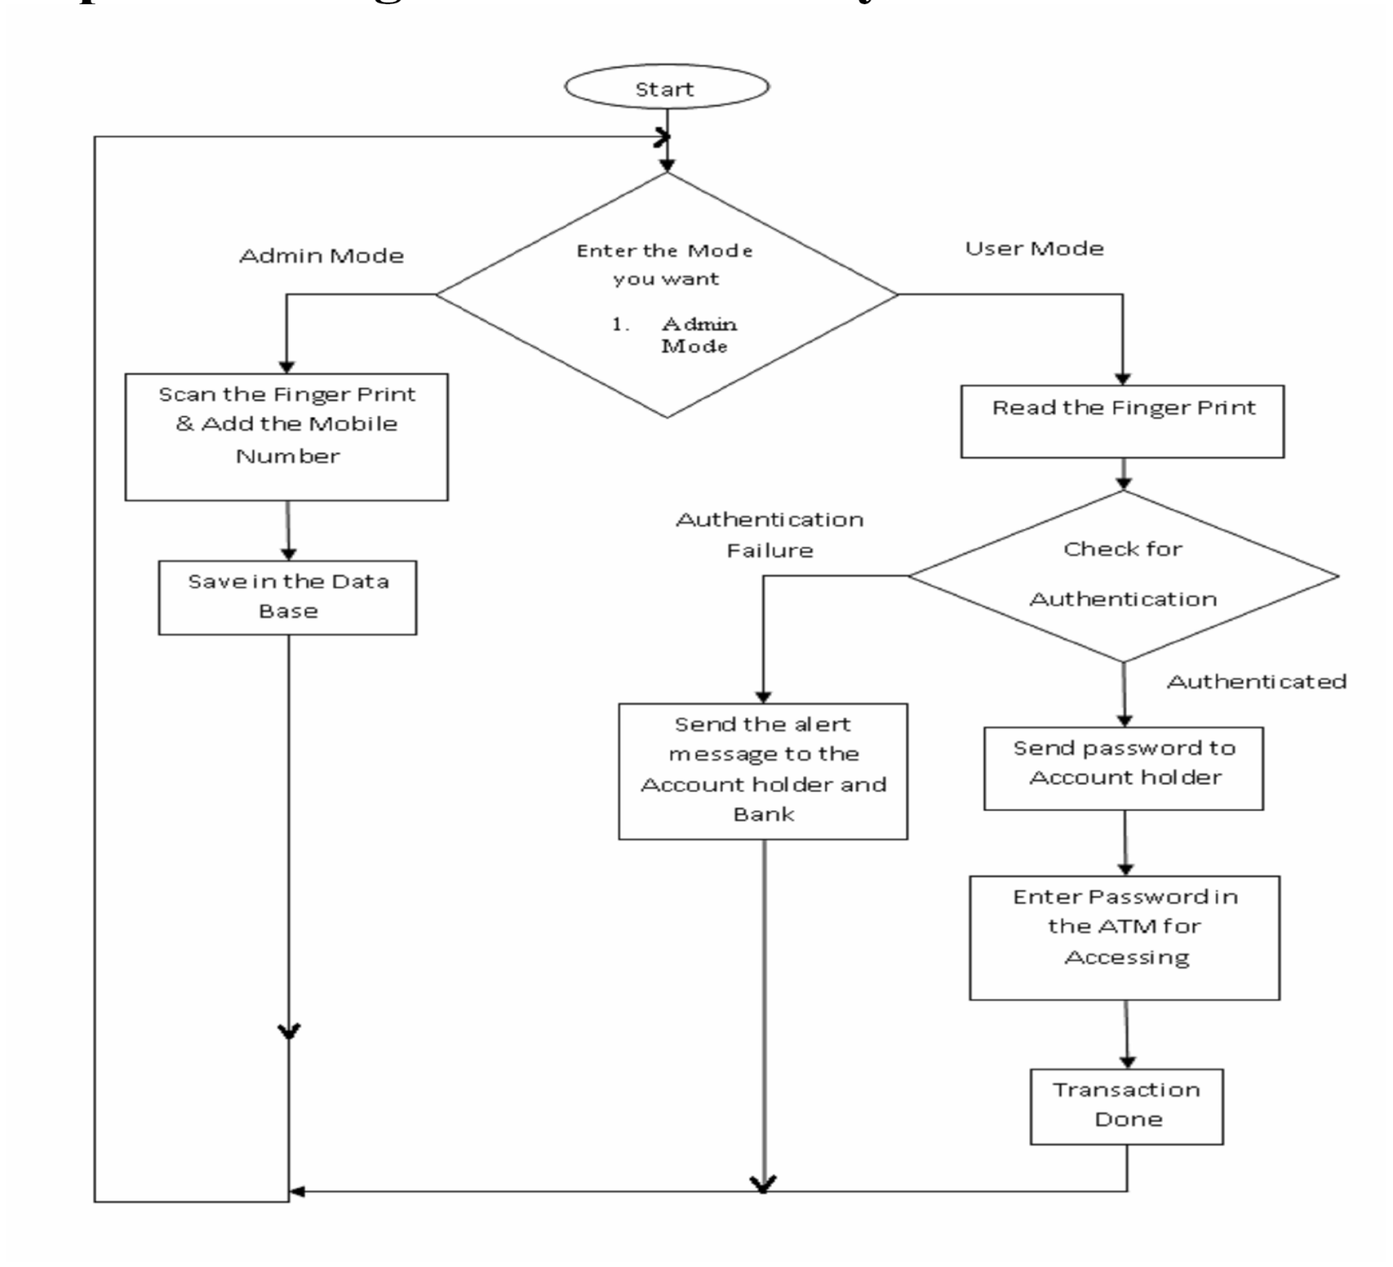
Flow chart

Slide 9
How does it work?
Database stores Bio-metric characteristics in admin mode.
Authentication process- User is required to provide finger print in user mode.
Validation – If the fingerprints match . User is considered as a valid user.
Transactions are done after verification of password (finger print)

Slide 10
Phases of bio atm…..
VALID
INITIATION:
@ STORING BIOMETRIC SAMPLES
INPUT:
@ TAKING AUTHENTICATION SAMPLES FROM USER
PROCESSING:
@HERE, THE PROCESSING OR MATCHING OF BOTH SAMPLES ARE DONE
INVALID

Slide 11
CLASS DIAGRAM
CUSTOMER
Acc no.
Finger print
Database
Account no.
Finger print
Enter acc no.
fingerprint
Rejected or accepted
ATM MACHINE
ADMIN
Provides details
Customer Details
Fill()
Withdraw()
REPORTS()

Slide 12
Get user
information
Balance
enquiry
extends
Cash
withdrawl
USER
Checking user
Update database
<include>
DATABASE
User
Registration
ADMIN
<include>
Use Case Diagram..

